Slide 1




CS621 Parallel and Distributed Computing
Dr. Muhammad Anwaar Saeed
Dr. Said Nabi
Ms. Hina Ishaq

Slide 2
CS621 Parallel and Distributed Computing
Concurrency Control

Slide 3
Objectives
What is Concurrency?
Mechanisms for Concurrency Control.

Slide 4
Definition of Concurrency
“Concurrency is the task of running two or more computations over the same time interval. Two events are said to be concurrent if they occur within the same time interval.”

Slide 5


What is Concurrency?
Concurrent doesn't necessarily mean at the same exact instant. For example, two tasks may occur concurrently within the same second but with each task executing within different fractions of the second.
Concurrent tasks can execute in a single or multiprocessing environment.
In a single processing environment, concurrent tasks exist at the same time and execute within the same time period by context switching.
In a multiprocessor environment, if enough processors are free, concurrent tasks may execute at the same instant over the same time period. The determining factor for what makes an acceptable time period for concurrency is relative to the application.

Slide 6
Concurrency Control
There must be an implicit or explicit control over concurrency. It is both hazardous and unsafe when multiple flows of executions simultaneously operate in the same address space without any kind of agreement on ordered access. Two or more activities might access the same data and thus induce data corruption as well as inconsistent or invalid application state.
Multiple activities that work jointly on a problem need an agreement on their common progress. Both issues represent fundamental challenges of concurrency and concurrent programming.

Slide 7
Concurrency Control Cont…
Synchronization and Coordination are two basic approaches to tackle this challenge:
Synchronization is a mechanism that controls access on shared resources between multiple activities. It enforces exclusiveness and ordered access on the resource by different activities.
Coordination aims at the orchestration of collaborating activities.

Slide 8
Benefits of Concurrency
The overall time to perform the series of tasks is reduced.
Concurrent processes can reduce duplication in code.
The overall runtime of the algorithm can be significantly reduced.
Concurrency control can also increase the scalability of parallel and distributed computing systems
Redundancy can make systems more reliable.
More real-world problems can be solved than with sequential algorithms alone.

Slide 9
CS621 Parallel and Distributed Computing
Concurrency Control: Basic Approaches to Achieving Concurrency

Slide 10
Objectives
Understanding of Concurrency Control.
Parallel Programming Technique.
Distributed Programming Technique.

Slide 11
Achieving Concurrency
Parallel programming and distributed programming are two basic approaches for achieving concurrency:
Parallel programming techniques assign the work a program has do to two or more processors within a single physical or a single virtual computer.
Distributed programming techniques assign the work a program has to do to two or more processes where the processes may or may not exist on the same computer.

Slide 12
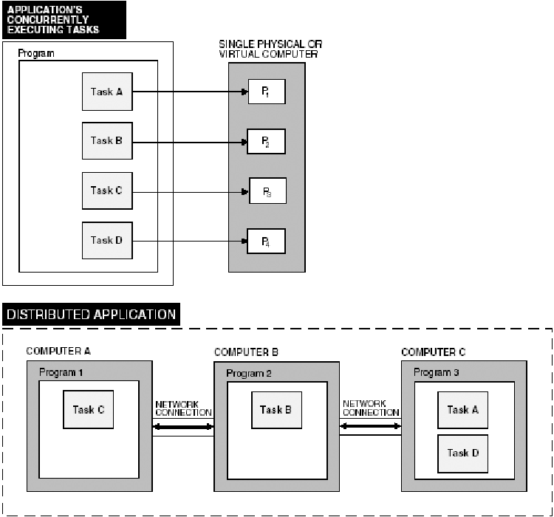
Achieving Concurrency: Parallel Programming Technique
The parallel application consists of one program divided into four tasks. Each task executes on a separate processor; therefore, each task may execute simultaneously. The tasks can be implemented by either a process or a thread.
Typical architecture for a parallel program.

Slide 13
Achieving Concurrency: Distributed Programming Technique
The distributed application consists of three separate programs with each program executing on a separate computer. Program 3 consists of two separate parts that execute on the same computer. Although task A and D of Program 3 are on the same computer, they are distributed because they are implemented by two separate processes.
Typical architecture for a parallel and distributed program.

Slide 14
CS621 Parallel and Distributed Computing
Concurrency Control: Models for Programming Concurrency

Slide 15
Objectives
Models of Programming Concurrency.
Van Roy Approaches for Programming Concurrency.

Slide 16
Concurrency Control: Models for Programming Concurrency
Van Roy introduces four main approaches for programming concurrency:
Sequential Programming.
Declarative Concurrency.
Message-passing Concurrency.
Shared-state Concurrency.

Slide 17
Sequential Programming
In this deterministic programming model, no concurrency is used at all. In its strongest form, there is a total order of all operations of the program. Weaker forms still keep the deterministic behavior. However, they either make no guarantees on the exact execution order to the programmer a priori. Or they provide mechanisms for explicit preemption of the task currently active, as co-routines do, for instance.

Slide 18
Declarative Concurrency
Declarative programming is a programming model that favors implicit control flow of computations. Control flow is not described directly, it is rather a result of computational logic of the program. The declarative concurrency model extends the declarative programming model by allowing multiple flows of executions. It adds implicit concurrency that is based on a data-driven or a demand-driven approach. While this introduces some form of nondeterminism at runtime, the nondeterminism is generally not observable from the outside.

Slide 19
Message-passing Concurrency
This model is a programming style that allows concurrent activities to communicate via messages. Generally, this is the only allowed form of interaction between activities which are otherwise completely isolated. Message passing can be either synchronous or asynchronous resulting in different mechanisms and patterns for synchronization and coordination.

Slide 20
Shared-state Concurrency
Shared-state concurrency is an extended programming model where multiple activities are allowed to access contended resources and states. Sharing the exact same resources and states among different activities requires dedicated mechanisms for synchronization of access and coordination between activities. The general nondeterminism and missing invariants of this model would otherwise directly cause problems regarding consistency and state validity.

Slide 21
CS621 Parallel and Distributed Computing
Memory Hierarchies

Slide 22
Objectives
Introduction of Memory Hierarchy.
Characteristics of Memory Hierarchy.

Slide 23
Memory Hierarchies
“Memory Hierarchy, in Computer System Design, is an enhancement that helps in organizing the memory so that it can minimize the access time. The development of the Memory Hierarchy occurred on a behavior of a program known as locality of references.”

Slide 24
Memory Hierarchies Cont…
We are concerned with five types of memory:
Registers: are the fastest type of memory, which are located internal to a processor. These elements are primarily used for temporary storage of operands, small partitions of memory, etc., and are assumed to be one word (32 bits) in length in the MIPS architecture.
Cache: is a very fast type of memory that can be external or internal to a given processor. Cache is used for temporary storage of blocks of data obtained from main memory (read operation) or created by the processor and eventually written to main memory (write operation).
Main Memory: is modelled as a large, linear array of storage elements that is partitioned into static and dynamic storage. Main memory is used primarily for storage of data that a program produces during its execution, as well as for instruction storage.
Disk Storage: is much slower than main memory, but also has much higher capacity than the preceding three types of memory.
Archival Storage: is offline storage such as a CD-ROM jukebox or (in former years) rooms filled with racks containing magnetic tapes. This type of storage has a very long access time, in comparison with disk storage, and is also designed to be much less volatile than disk data.

Slide 25
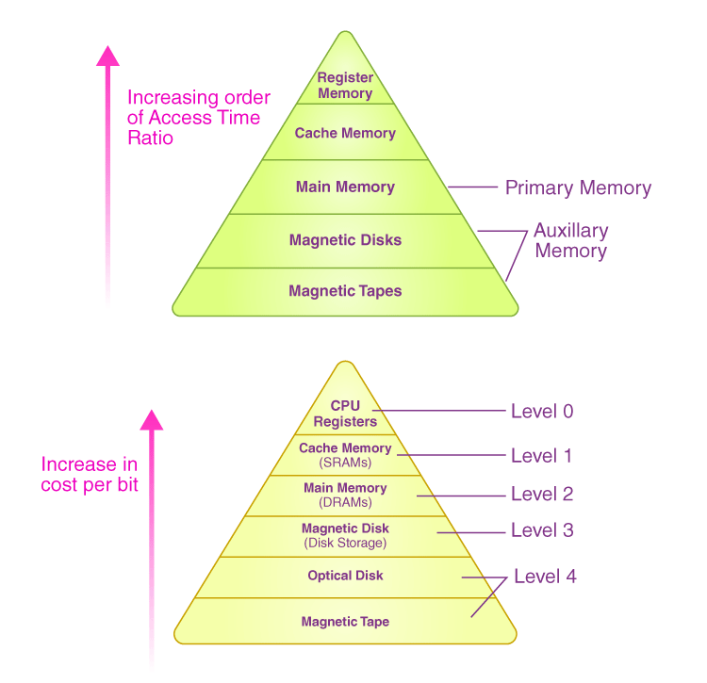
Memory Hierarchies Cont…

Slide 26
Characteristics of Memory Hierarchy
Characteristics of a Memory Hierarchy can be inferred from the previous figure:
Capacity: It refers to the total volume of data that a system’s memory can store. The capacity increases moving from the top to the bottom in the Memory Hierarchy.
Access Time: It refers to the time interval present between the request for read/write and the data availability. The access time increases as we move from the top to the bottom in the Memory Hierarchy.

Slide 27
Characteristics of Memory Hierarchy Cont..
Characteristics of a Memory Hierarchy can be inferred from the previous figure:
Performance: When a computer system was designed earlier without the Memory Hierarchy Design, the gap in speed increased between the given CPU registers and the Main Memory due to a large difference in the system’s access time. It ultimately resulted in the system’s lower performance, and thus, enhancement was required. Such a kind of enhancement was introduced in the form of Memory Hierarchy Design, and because of this, the system’s performance increased. One of the primary ways to increase the performance of a system is minimizing how much a memory hierarchy has to be done to manipulate data.
Cost per bit: The cost per bit increases as one moves from the bottom to the top in the Memory Hierarchy, i.e. External Memory is cheaper than Internal Memory.

Slide 28
CS621 Parallel and Distributed Computing
Limitations of Memory System Performance

Slide 29
Objectives
Understanding of Limitations of Memory System Performance.
Memory Latency Example.

Slide 30
Limitations of Memory System Performance
Memory system, and not processor speed, is often the bottleneck for many applications.
Memory system performance is largely captured by two parameters, latency and bandwidth.
Latency: Is the time from the issue of a memory request to the time the data is available at the processor.
Bandwidth: Is the rate at which data can be pumped to the processor by the memory system.

Slide 31
Limitations of Memory System Performance Cont…
It is very important to understand the difference between latency and bandwidth.
Consider the example of a fire-hose. If the water comes out of the hose two seconds after the hydrant is turned on, the latency of the system is two seconds.
Once the water starts flowing, if the hydrant delivers water at the rate of 5 gallons/second, the bandwidth of the system is 5 gallons/second.
If you want immediate response from the hydrant, it is important to reduce latency.
If you want to fight big fires, you want high bandwidth.

Slide 32
Memory Latency Example
Consider a processor operating at 1 GHz (1 ns clock) connected to a DRAM with a latency of 100 ns (no caches). Assume that the processor has two multiply-add units and is capable of executing four instructions in each cycle of 1 ns. The following observations follow:
  The peak processor rating is 4 GFLOPS.
  Since the memory latency is equal to 100 cycles and block size is one word, every time a memory request is made, the processor must wait 100 cycles before it can process the data.

Slide 33
CS621 Parallel and Distributed Computing
Improving Effective Memory
Latency Using Caches

Slide 34
Objectives
Effect of Cache.
Effect of Cache with Example.

Slide 35
Improving Effective Memory Latency Using Caches
Caches are small and fast memory elements between the processor and DRAM.
This memory acts as a low-latency high-bandwidth storage.
If a piece of data is repeatedly used, the effective latency of this memory system can be reduced by the cache.
The fraction of data references satisfied by the cache is called the cache hit ratio of the computation on the system.
Cache hit ratio achieved by a code on a memory system often determines its performance.

Slide 36
Effect of Cache
Repeated references to the same data item correspond to temporal locality.
In our example, we had O(n2) data accesses and O(n3) computation. This asymptotic difference makes the above example particularly desirable for caches.
Reduce network congestion and improve overall performance.

Slide 37
Effect of Cache Example
Continue the previous example of memory latency, we introduce a cache of size 32 KB with a latency of 1 ns or one cycle. We use this setup to multiply two matrices A and B of dimensions 32 × 32(8KB or 1K words for each matrix). We have carefully chosen these numbers so that the cache is large enough to store matrices A and B, as well as the result matrix C.
1GHz processor, 4GFLOPS theoretical peak, 100ns memory Latency.
Assume 1ns cache latency (full-speed cache)

Slide 38
Effect of Cache Example Cont…
The following observations can be made about the problem:
Fetching the two matrices into the cache corresponds to fetching 2K words, which takes approximately 200 µs.
Multiplying two n × n matrices takes 2n3 operations. For our problem, this corresponds to 64K operations, which can be performed in 16K cycles (or 16 µs) at four instructions per cycle.
The total time for the computation is therefore approximately the sum of time for load/store operations and the time for the computation itself, i.e., 200 + 16 µs.
This corresponds to a peak computation rate of 64K/216 or 303 MFLOPS.

Slide 39
CS621 Parallel and Distributed Computing
Effect of Memory Bandwidth

Slide 40
Objectives
Effect of Memory Bandwidth.
Effect of Memory Bandwidth Example.

Slide 41
Effect of Memory Bandwidth
Memory bandwidth is determined by the bandwidth of the memory bus as well as the memory units.
Memory bandwidth can be improved by increasing the size of memory blocks.
The performance of the CPU or GPU can also impact memory bandwidth.

Slide 42
Effect of Memory Bandwidth Example
Consider the same setup as in previous topic, except in this case, the block size is 4 words instead of 1 word. We repeat the dot-product computation in this scenario:
Assuming that the vectors are laid out linearly in memory, eight FLOPs (four multiply-adds) can be performed in 200 cycles.
This is because a single memory access fetches four consecutive words in the vector.
Therefore, two accesses can fetch four elements of each of the vectors. This corresponds to a FLOP every 25 ns, for a peak speed of 40 MFLOPS.

Slide 43
Effect of Memory Bandwidth Example Cont…
It is important to note that increasing block size does not change latency of the system.
Physically, the scenario illustrated here can be viewed as a wide data bus (4 words or 128 bits) connected to multiple memory banks.
In practice, such wide buses are expensive to construct.
In a more practical system, consecutive words are sent on the memory bus on subsequent bus cycles after the first word is retrieved.

Slide 44
Effect of Memory Bandwidth Example Cont…
The above examples clearly illustrate how increased bandwidth results in higher peak computation rates.
The data layouts were assumed to be such that consecutive data words in memory were used by successive instructions (spatial locality of reference).
If we take a data-layout centric view, computations must be reordered to enhance spatial locality of reference.

